Slide 1
Hotel Data Analysis Divyansh Kumar Gupta

Slide 2
Project analysis slide 11
Business
Objective
The objective of the project is to analyse a hotel dataset to optimize various aspects of operations, boost revenue streams, and create a more efficient and satisfying experience for guests.

Slide 3

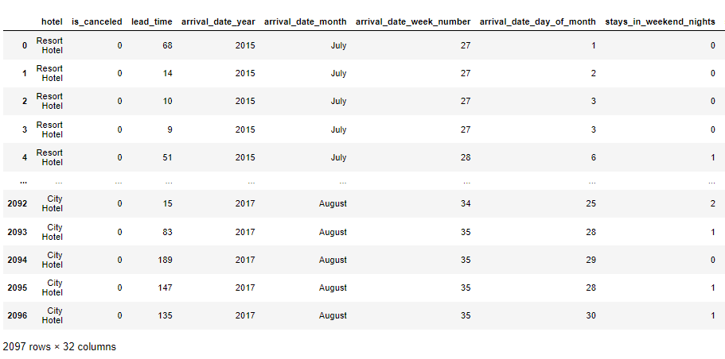
Project analysis slide 11
Dataset

Slide 4
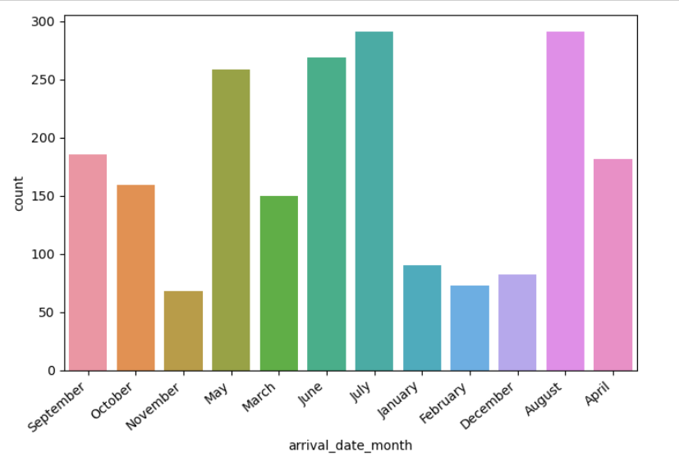
Project analysis slide 11
Peak Month For
Hotel Arrival
This suggests that from the month of May to August is possibly the peak months for hotel arrivals.

Slide 5
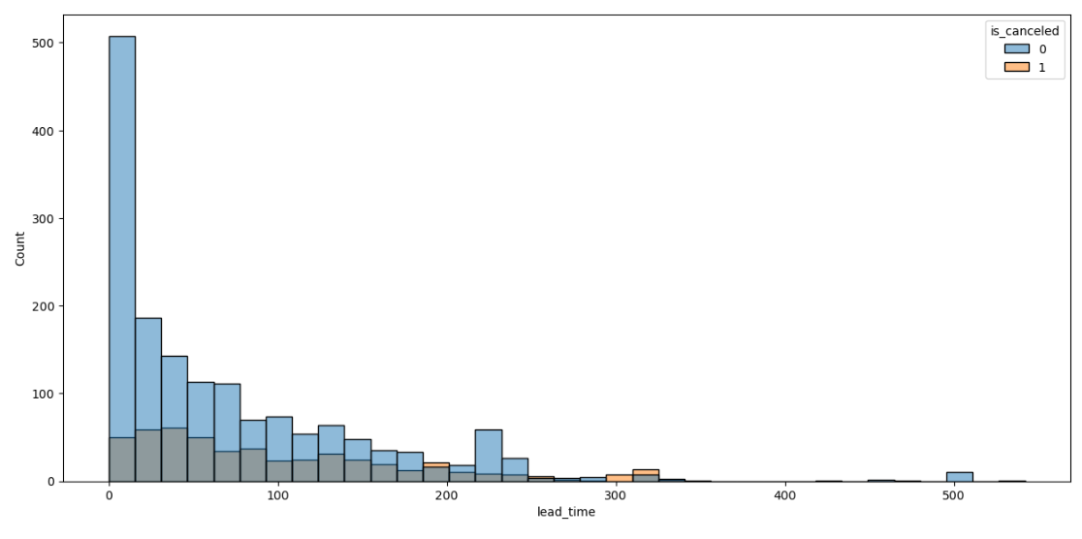
Project analysis slide 11
Lead Time Wise
Cancellation Status
It appears that shorter lead times, indicating bookings made closer to the arrival date, are associated with a higher likelihood of not cancelling the hotel booking.

Slide 6
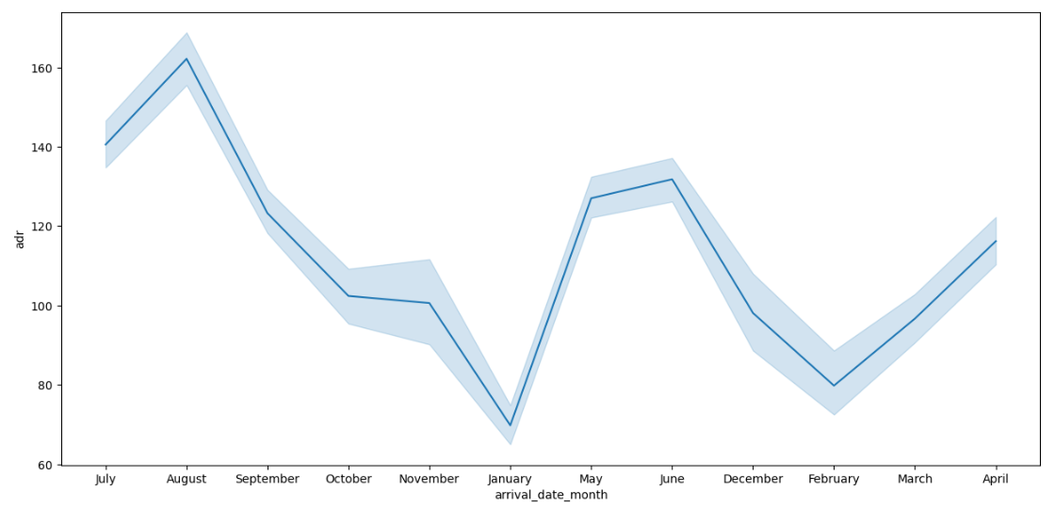
Project analysis slide 11
Month Wise
Average Daily Rate
It appears that in the month of August the average daily rate was all time high.

Slide 7
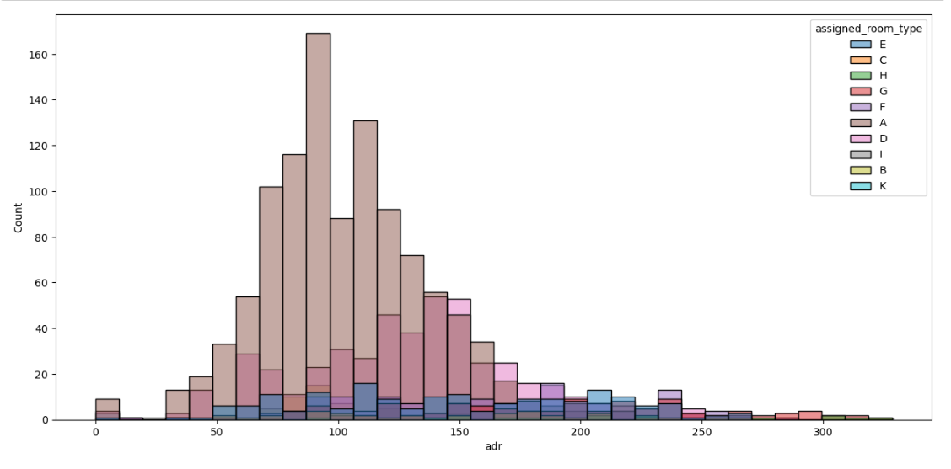
Project analysis slide 11
Room Type Wise
Average Daily Rate
It shows that majority of customers with assigned room type A has an average daily rate between 50 to 150.

Slide 8
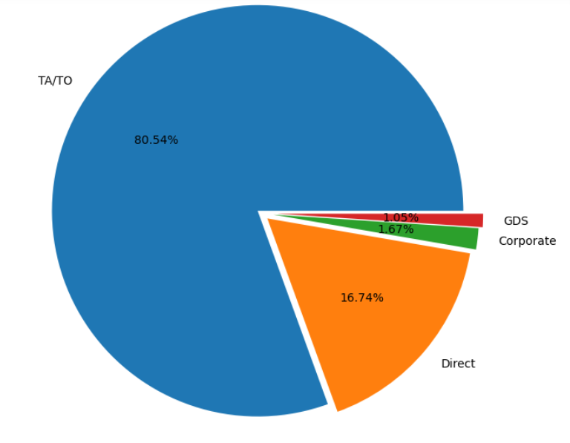
Project analysis slide 11
Distribution Channel
Pie Chart
Travel Agents or tour operators has the highest portion of booking i.e, approximately 80%

Slide 9
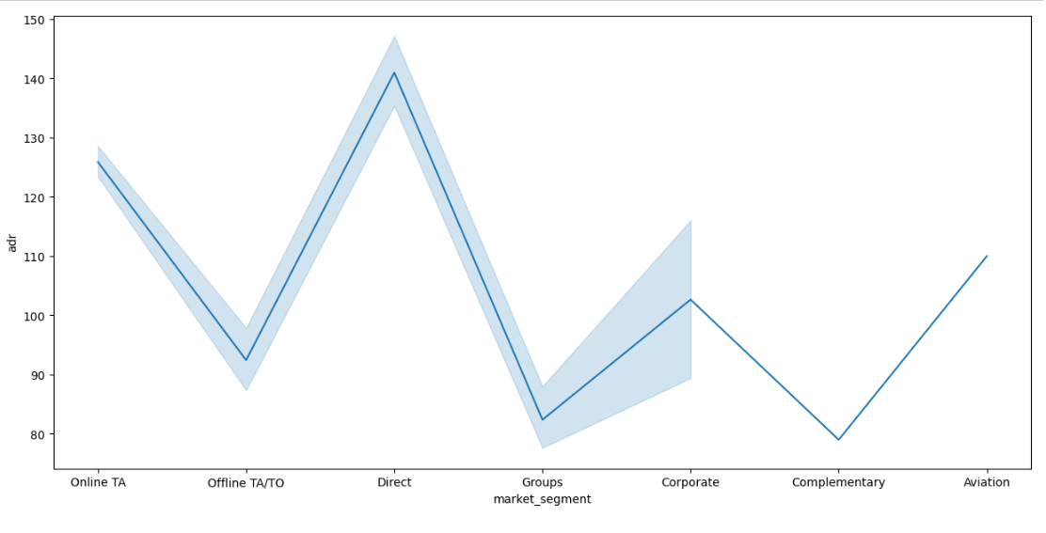
Project analysis slide 11
Market Segment Wise
Average Daily Rate
It appears that direct market segment has the highest average daily rate.

Slide 10
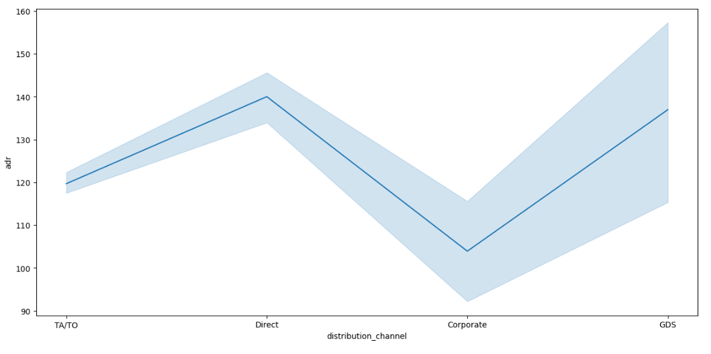
Project analysis slide 11
Distribution Channel
Wise
Average Daily Rate
It appears that in direct and GDS distribution channel the average daily rate is highest whereas for corporate distribution channel it is the lowest.

Slide 11
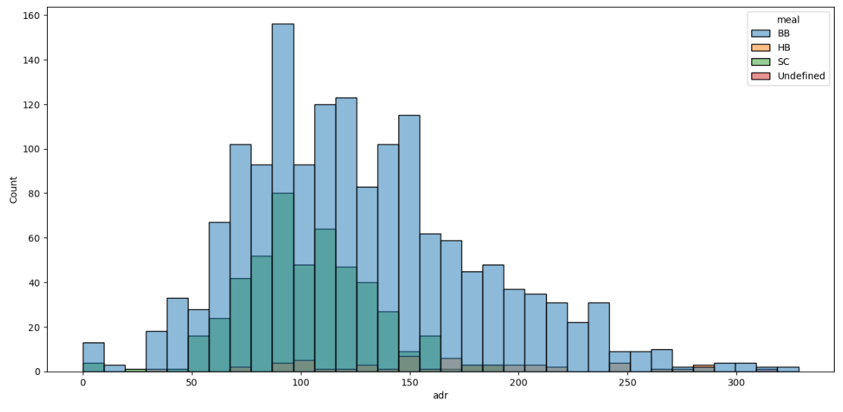
Project analysis slide 11
Meal Type Wise
Average Daily Rate
Most of the customers who have an average daily rate between 50 to 100 has bed breakfast included in their package whereas the second highest count of customers having an average daily rate between 90 - 100 have self catering meal type.

Slide 12
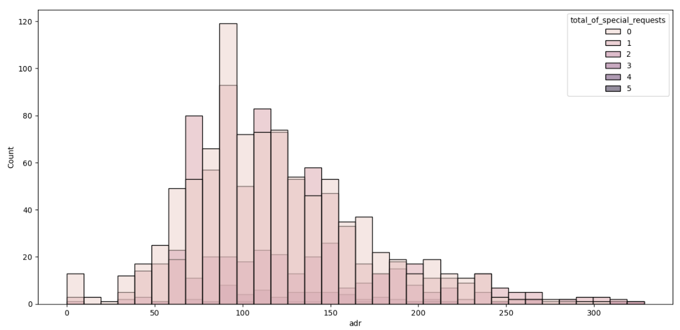
Project analysis slide 11
Total Special Request
Wise
Average Daily Rate
Most of the customers with an average daily rate between 60 to 130 have 0 or 1 special request and only nominal count of customers have 2 or 3 special request.

Slide 13
Project analysis slide 11
Conclusion
The analysis of the hotel dataset reveals significant trends and patterns that can inform strategic decisions. 2016 emerges as a peak year for hotel arrivals, with May to August being the peak months. Lead time above 400 days indicates minimal chances of cancellation, while high cancellations are observed in city hotels during the peak months. Customers booking closer to their arrival date exhibit higher commitment, while fewer special requests are associated with higher cancellation rates. Room type A and transient customers show the highest cancellation rates, with insights into their preferences shedding light on cancellation probabilities. Moreover, the average daily rate peaks in August, with variations across different market segments and distribution channels. Understanding these dynamics is crucial for optimizing revenue and managing cancellation risks effectively.

Slide 14
Project analysis slide 11
Final Recommendation
Based on the insights gleaned from the comprehensive analysis of the hotel dataset, it is recommended that the hotel management focus on optimizing revenue and mitigating cancellation risks by implementing targeted strategies. This includes offering incentives for early bookings, especially during the peak months of May to August, and incentivizing guests to make reservations directly rather than through third-party channels, given the higher average daily rates associated with direct bookings. Additionally, efforts should be made to understand and cater to the preferences of transient guests, who exhibit the highest cancellation rates, by offering personalized experiences or packages tailored to their needs. Moreover, considering the correlation between shorter lead times and higher commitment to reservations, the hotel can explore dynamic pricing strategies to capitalize on last-minute bookings while minimizing the risk of cancellations. By leveraging these insights and implementing strategic initiatives, the hotel can enhance revenue generation and improve overall operational efficiency.

Slide 15
Thank You

